Slide 1
Cloud Computing Security
Let’s clear the air.
Frances Coronel
CSC 120 | Final Project

Slide 2
Outline
What is cloud computing security?
Specific Computer Functions and Models
Human Impact
Data Impact
How the Security Can Be Improved
Excel Document
Word Document
References

Slide 3
So what is cloud computing security?
Key Characteristics & Advantages
Software Integration
Cost Efficient
More Secure
Document Control
Backup & Recovery
Streamline Work-Flow
Rapid Development
Infinite Storage
More Flexible
The act of protecting data in 3rd party data centers.

Slide 4
Specific Computer Functions and Models
SaaS | PaaS | IaaS
Content Resource Management (CRM) | Databases | Virtual Machines
Email, Communication | Web Servers | Servers & Networks
Games | Development Tools | Storage
SaaS – Software as a Service
Applications delivered over the web
PaaS – Platform as a Service
Set of tools designed to make coding and deploying those apps easy and quick
IaaS – Infrastructure as a Service
Hardware and software that powers all servers, storage, networks, and operating systems

Slide 5
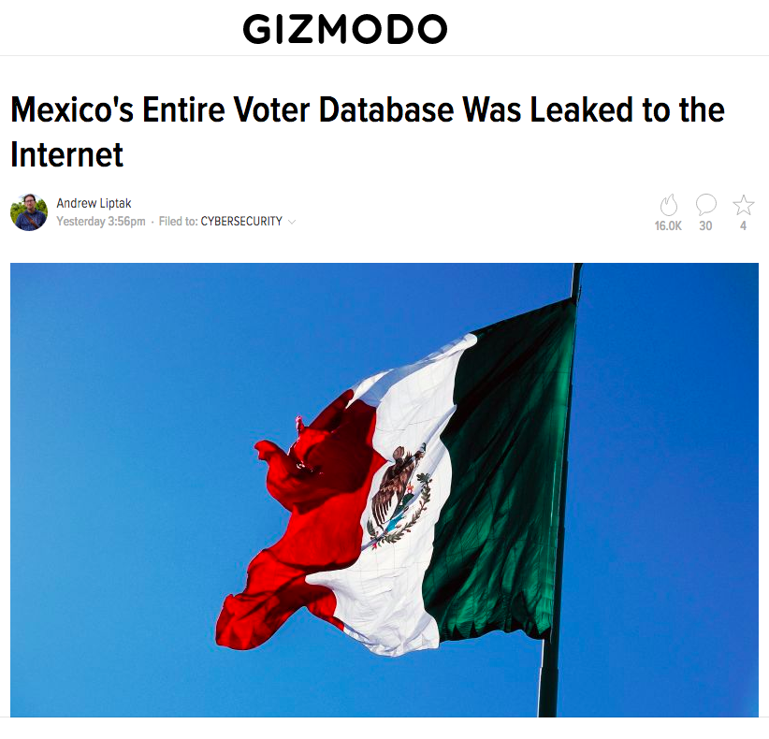
Humans Impacted N
Everyone has their data on the cloud now.
This means anyone’s data can be compromised.

Slide 6
Data Impact
Loss or theft of intellectual property
Compliance violations and regulatory actions
Malware infections that unleash a targeted attack
Diminished customer trust
Decreased contracts with business partners
Data breach requiring disclosure to victims
Revenue losses

Slide 7
How the Security Can Be Improved
Limit access of employees
Increase encryption with high-risk data
Watch device security in network
Backup plan in place

Slide 8
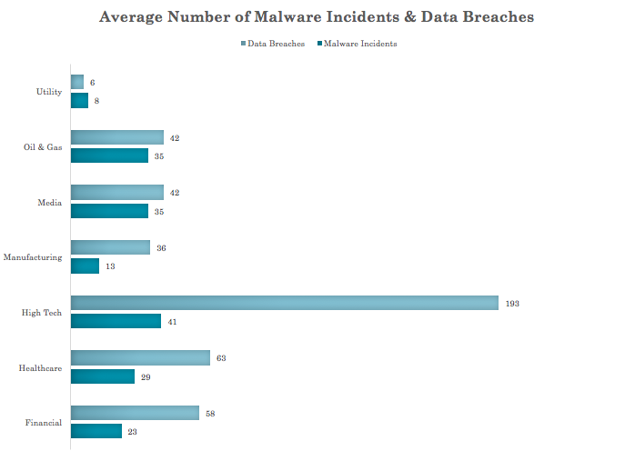
Excel Document
This chart examines the average number of malware incidents and data breaches
Can be concluded that high tech companies are exposed to most high-risk behavior
Conclusion makes sense since they tend to have more flexible policies regarding use of cloud services
Final Project - Excel.xlsx

Slide 9
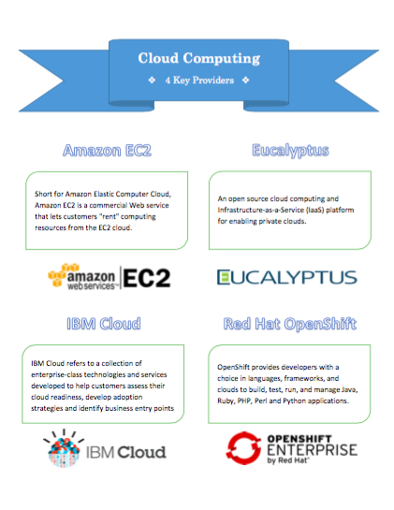
Word Document
This flyer gives a quick overview of who four key providers are when it comes to providing secure cloud computing.
These four providers are Amazon EC2, Eucalyptus, IBM Cloud, and Red Hat Open Shift.
They are all at the highest level of cloud computing, which is IaaS.
Final Project - Word.docx

Slide 10
References
https://www.wikiwand.com/en/Cloud_computing_security
http://www.infoworld.com/article/3041078/security/the-dirty-dozen-12-cloud-security-threats.html
https://apprenda.com/library/paas/iaas-paas-saas-explained-compared/
http://gizmodo.com/mexicos-entire-voter-database-was-leaked-to-the-interne-1772765367
http://cloudtweaks.com/2013/10/ways-improving-cloud-security/
https://www.skyhighnetworks.com/cloud-security-blog/9-cloud-computing-security-risks-every-company-faces/
http://www.webopedia.com/quick_ref/cloud_computing_terms.asp

